Slide 1
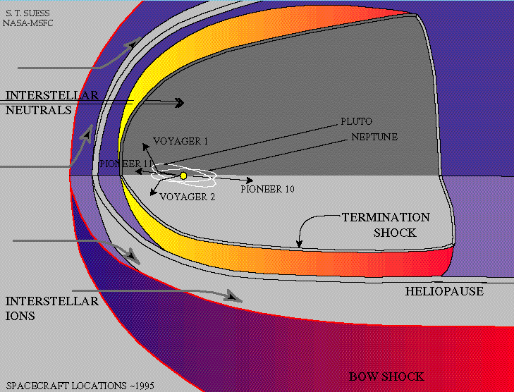
Solar Modulation
Heliosphere
In the heliopshere there is a variable supersonic solar wind with an embedded a “frozen-in” turbulent magnetic field.
This leads to global and temporal variations in the intensity of CR as a function of position inside the heliosphere.
This process is identified as the solar modulation of CR
A void in the local interstellar medium where Sun B field dominates
Modulation plays a role in galactic CR flux up to 30 GeV
Fundamental to deconvolve the LIS spectrum at low energy, ie spectra at Earth location below 30 GeV are NOT representative of the LIS spectrum

Slide 2
Low Energy Cosmic Rays
Not representative of LIS spectrum

Slide 3
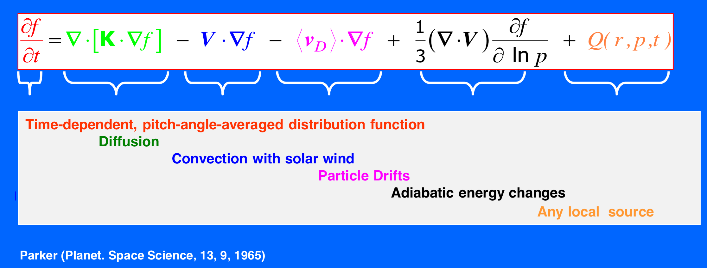
Propagation in the heliosphere is decribed by Parker (1965) equation:
Flux J = p²f
Diffusion
Convection
Drift
Energetic Loss
Small Scale Magnetic Field irregolarity
Presence of the solar wind moving out from the Sun
Large Scale structure of magnetic field
(gradients&curvature)
Due to adiabatic expansion of the solar wind

Slide 4
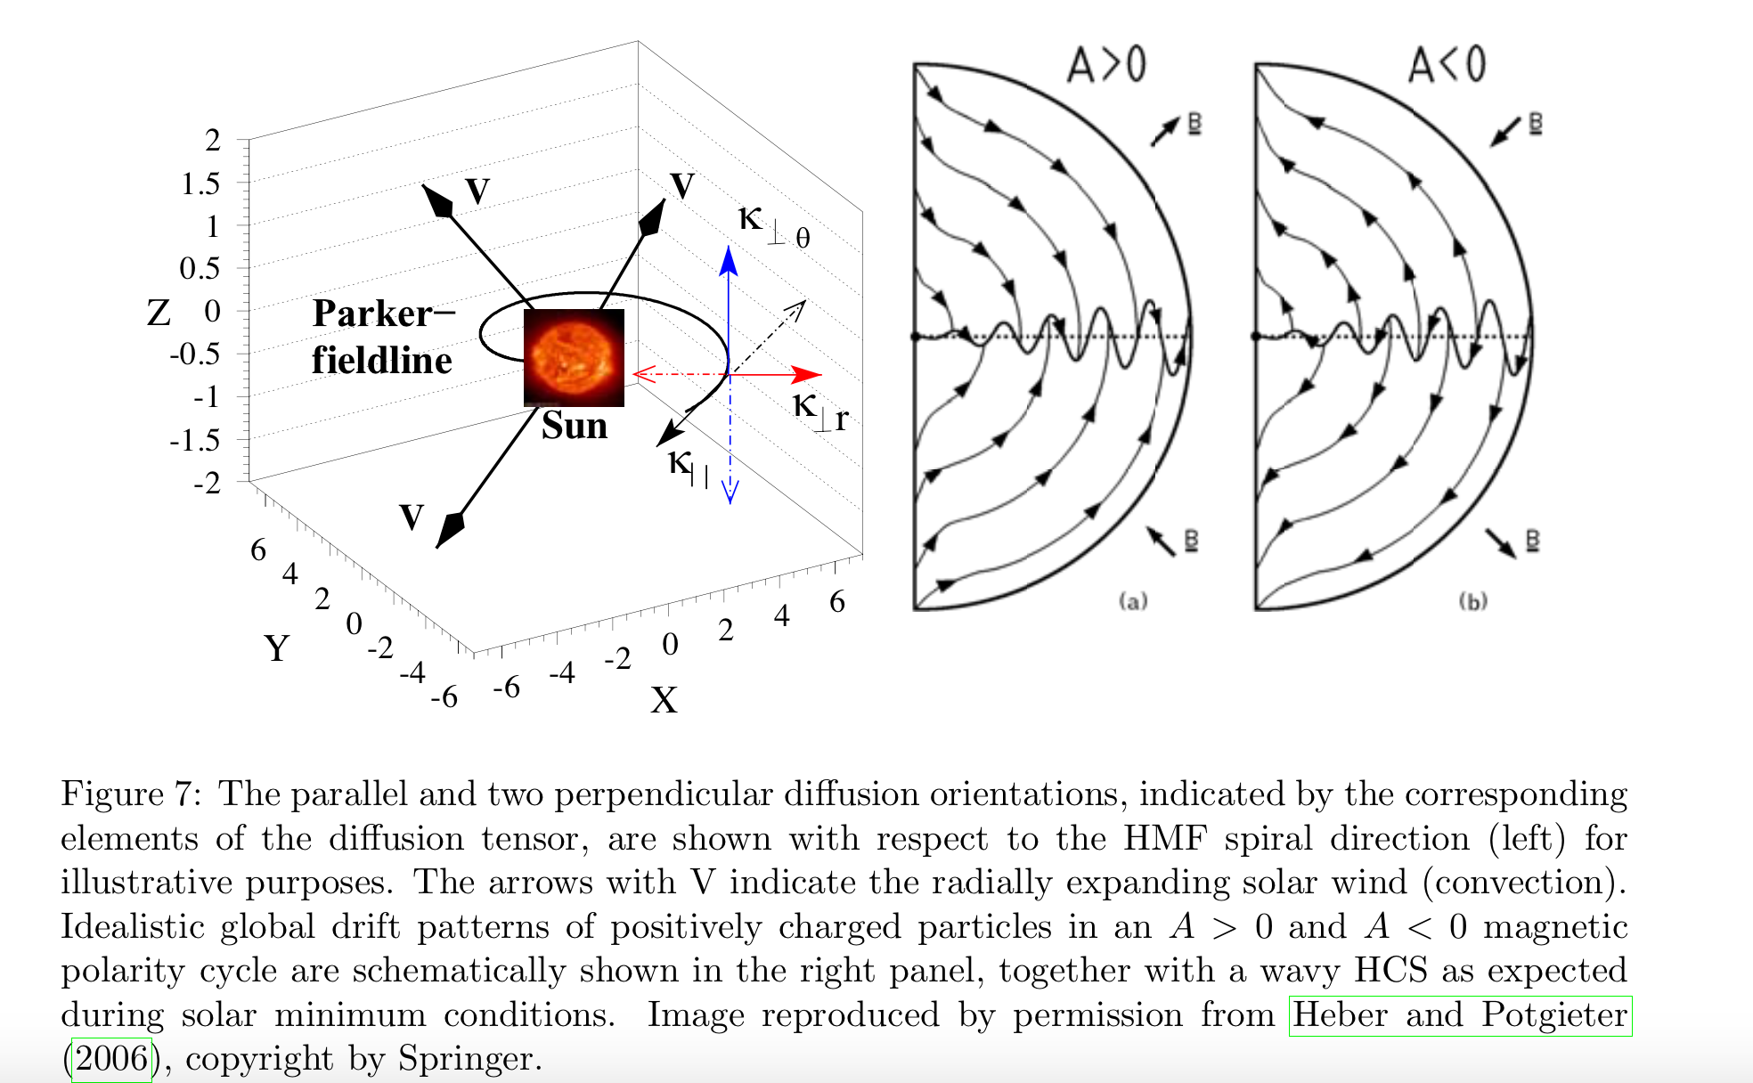
Diffusion is anisotropic along the parallel and perpendicular directions wrt the local B field
Needed three diffusion coefficients
They depend on the turbulence scale of the IMF
Described by QLT of turbulence

Slide 5
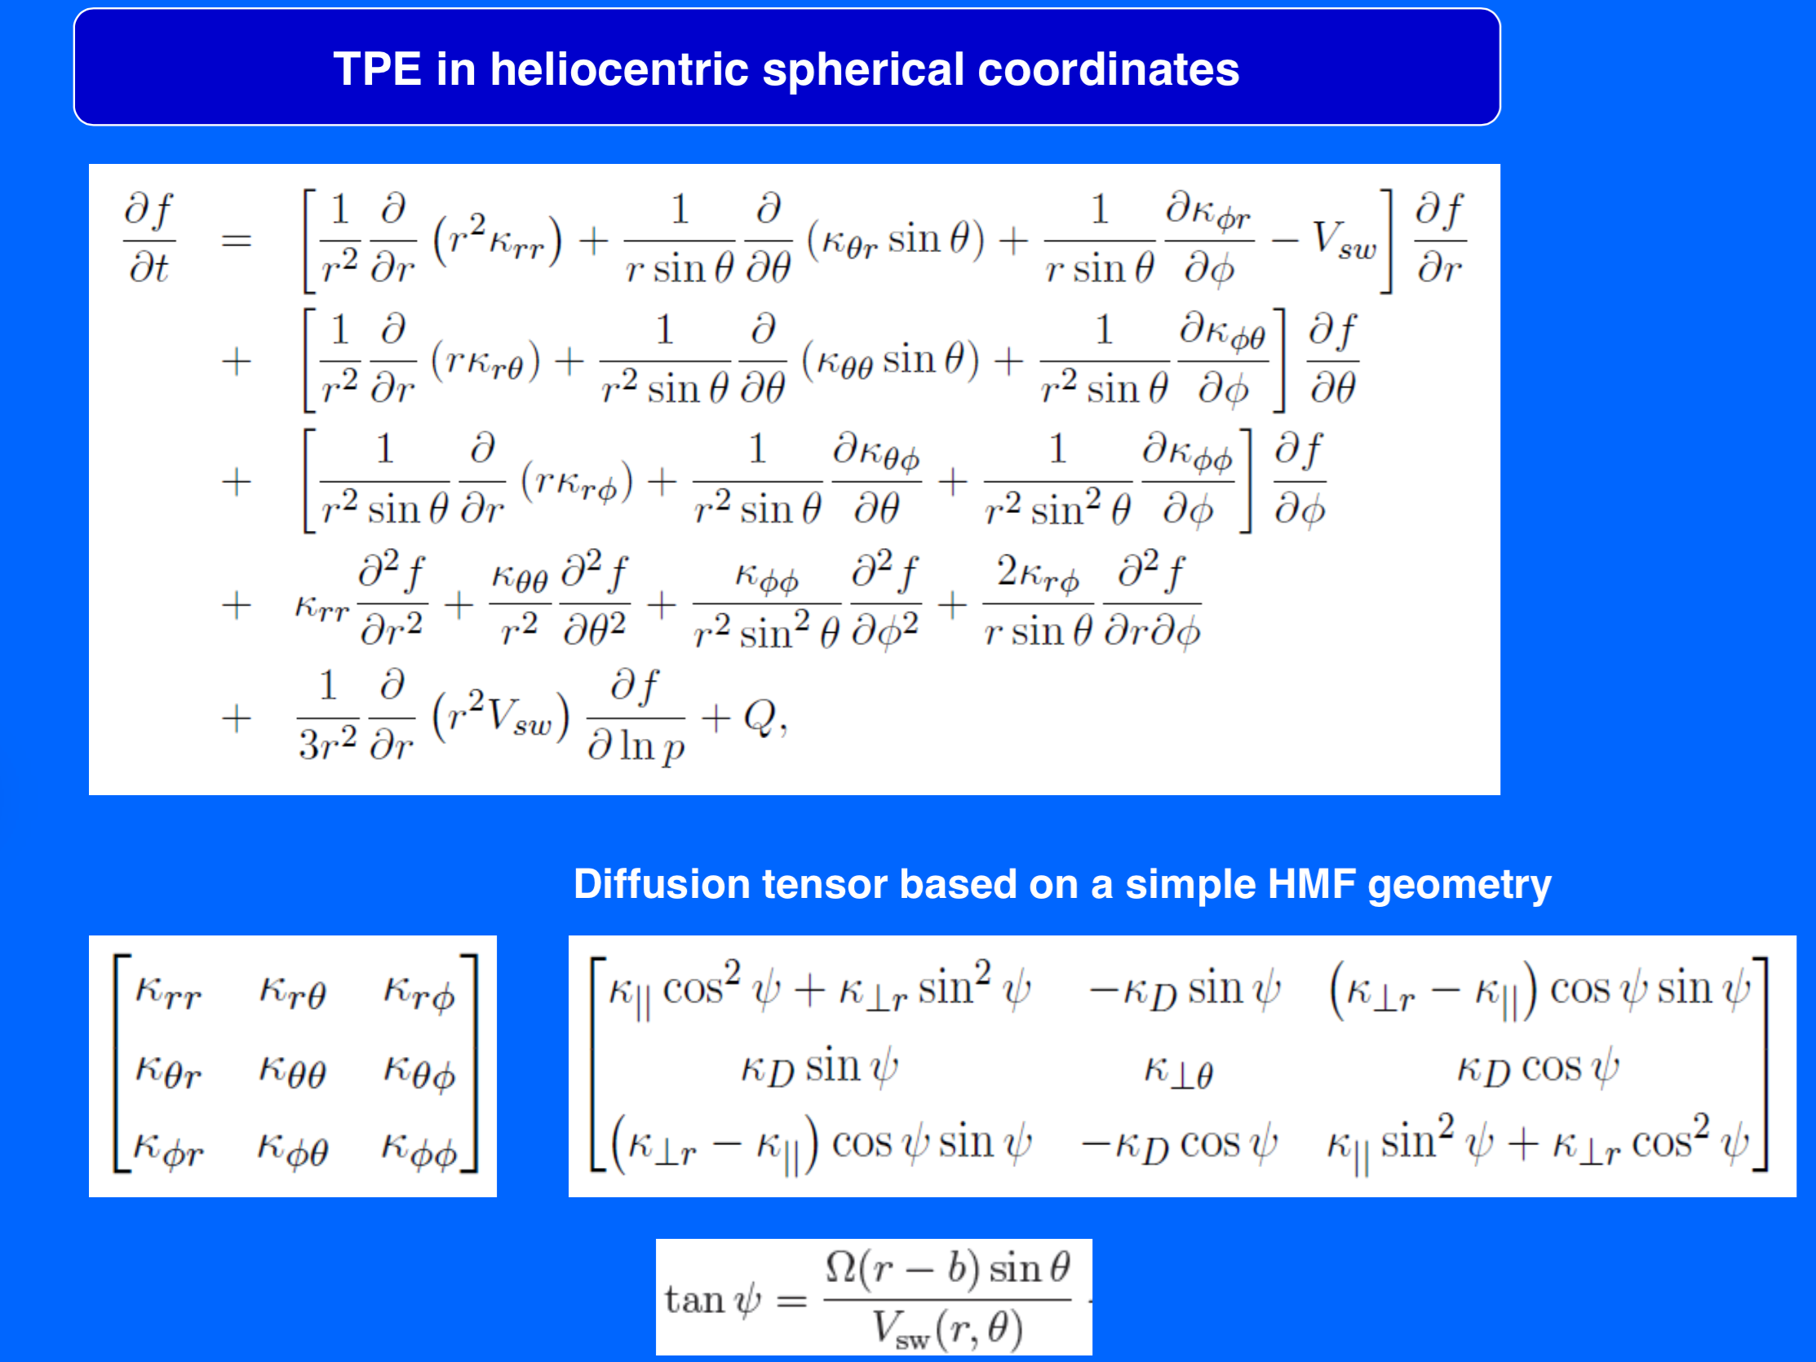
Effective diffusion tensor
=

Slide 6
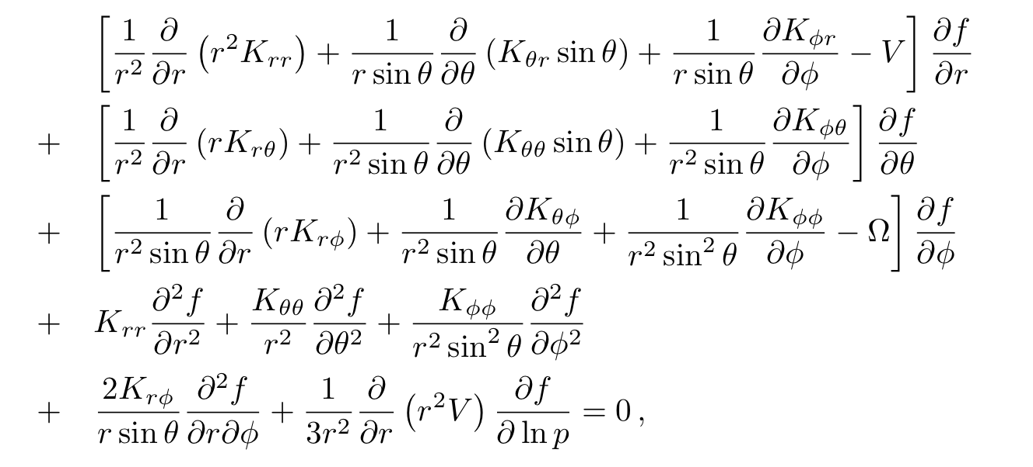
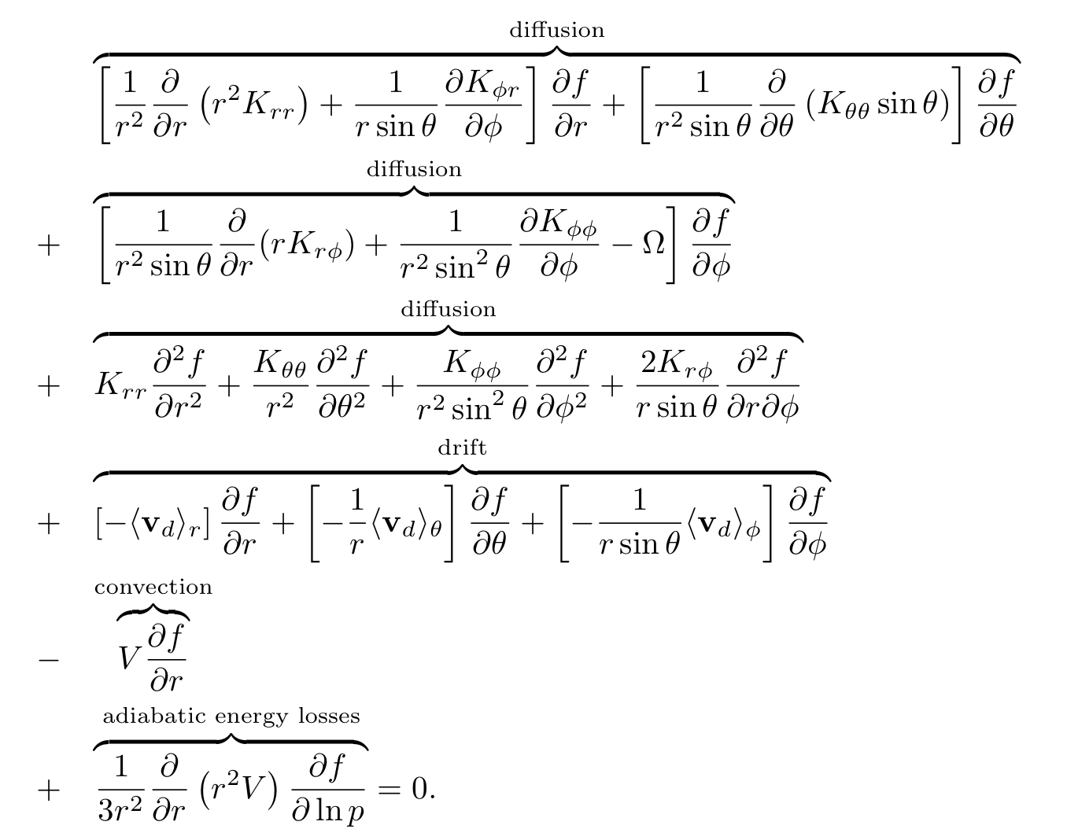
Model of Propagation
No local sources Q = 0
Stationary ∂/∂t=0
2D with axial symmetry ∂/∂Φ=0

Slide 7
SOLARPROP
Numerical integration is made by using the Stochastic Differential Equation approach with backward time integration in the framework of solarprop
Solarprop is a package (Kappl, Comp. Sc. , 2015) publicly available at XXXX
Very flexible, upgradable and user-friendly package
Original program modified for:
Some physics bugs corrected:
β = R/E instead of β = p/E
Drift speeds ~p instead of ~R
Angle for Neutral Drift Speed effects corrected
Parker Magnetic Field with polar corrections used
Parallel and perpendicular diffusion coefficients with breaks in rigidity implemented
Polar enhancement of tranverse perpendicular diffusion coeff K_{θθ}
Latitude- and tilt angle- dependent solar wind speed with termination shock

Slide 8
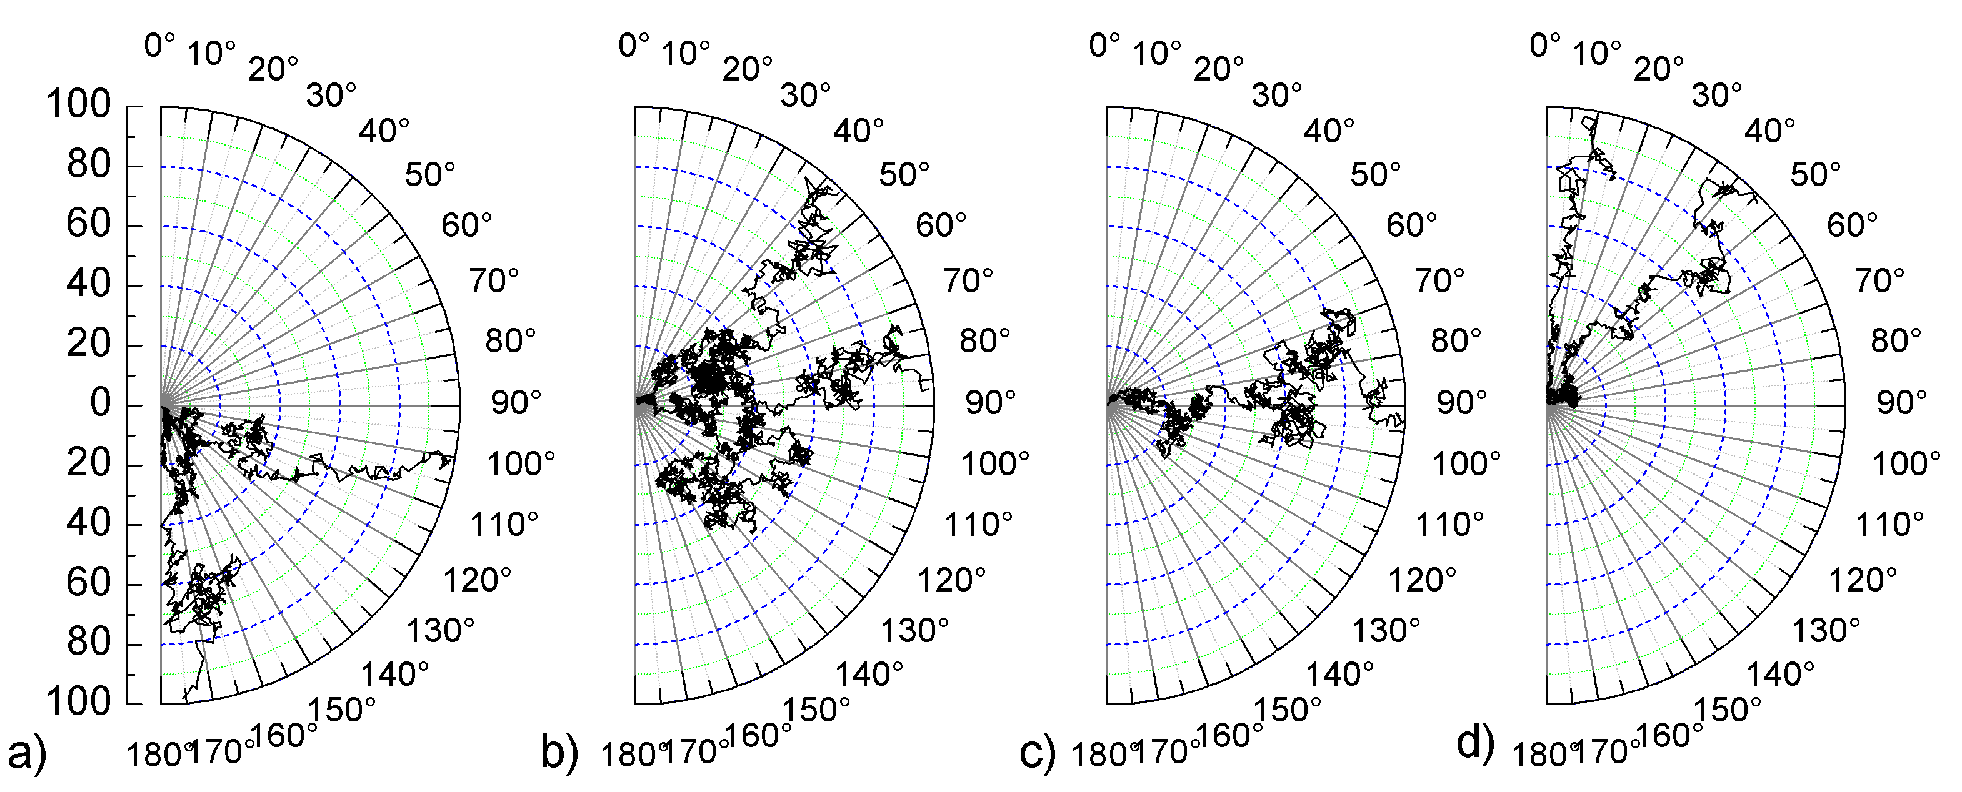
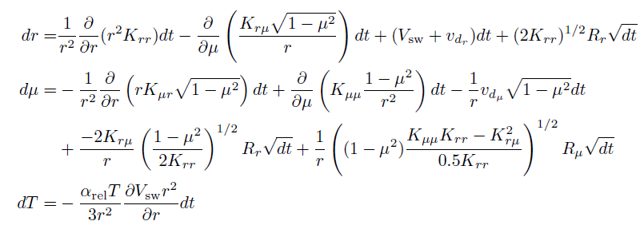
Parker
Equation
Ito’s lemma,
see e.g. Gardiner, 1985
Stochastic Differential Equations

Slide 9
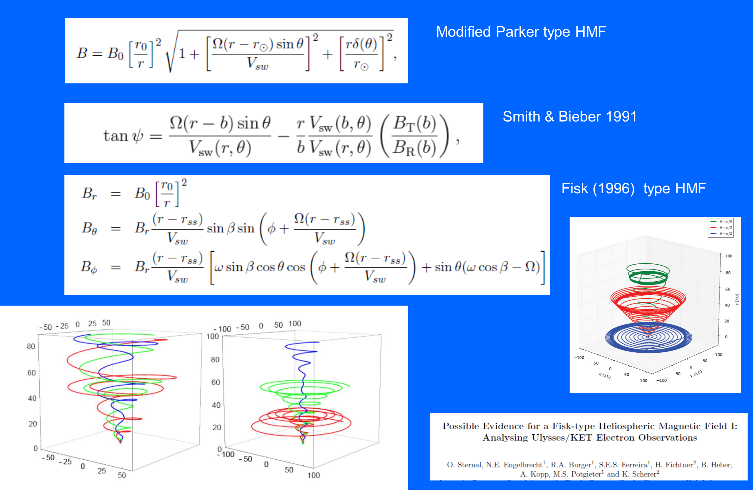
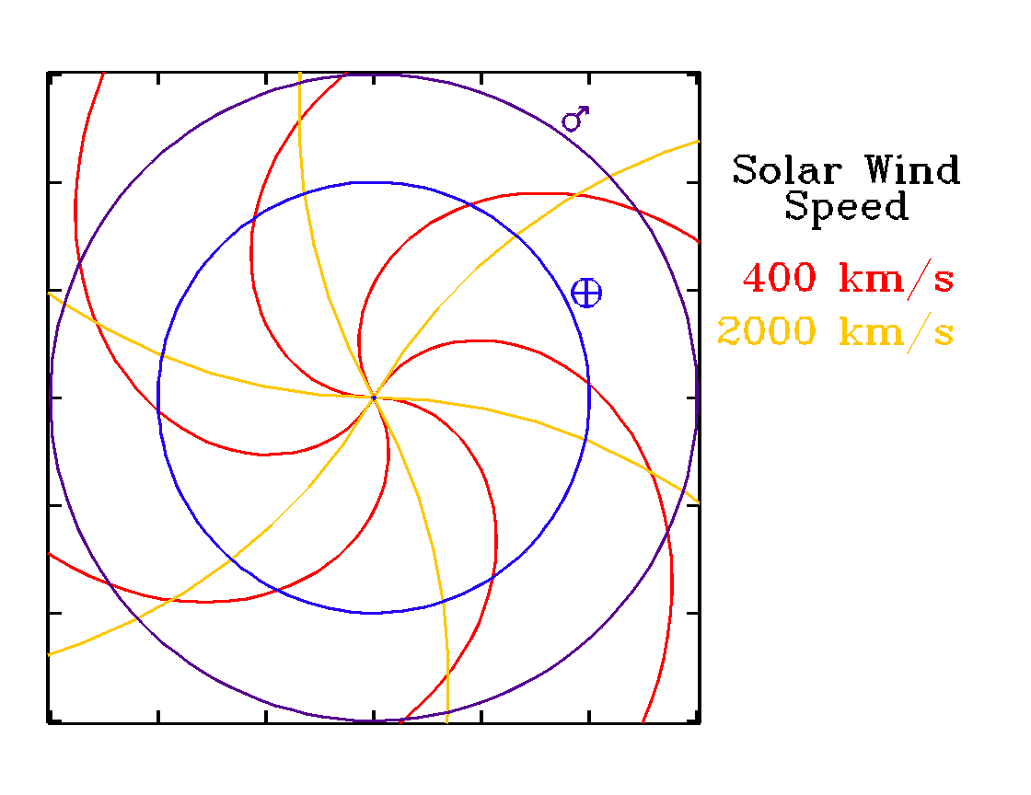
Magnetic Field
tg(ψ)=
Archimedean Spiral

Slide 10
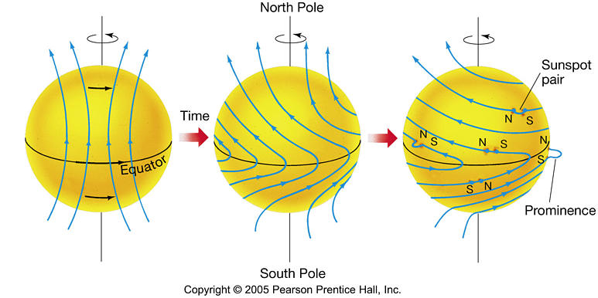
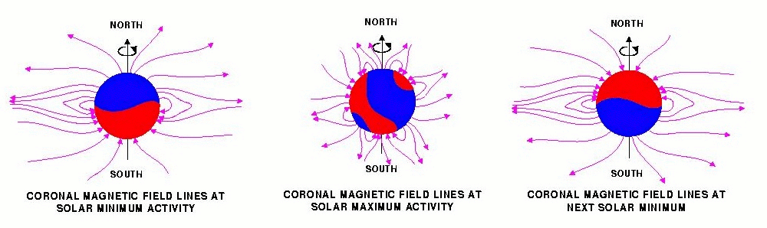
Field polarity A
Configuration for A>0
Configuration for A<0

Slide 11
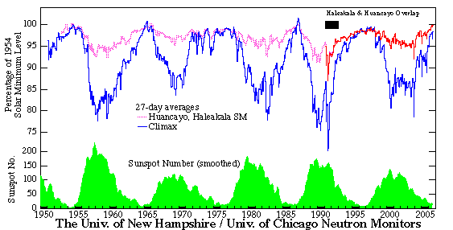
Solar Activity
A>0
A<0
A>0
A<0
A>0
A<0
The solar activity is related to:
- Sunspot number
(<10 minimum; >100 maximum)
- Wavy Neutral Sheet opening/tilt angle
(10° minimum ; >75° maximum)

Slide 12
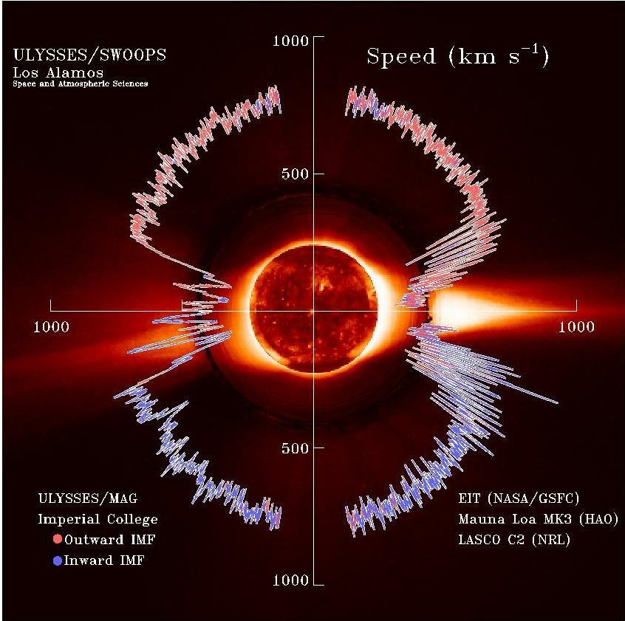
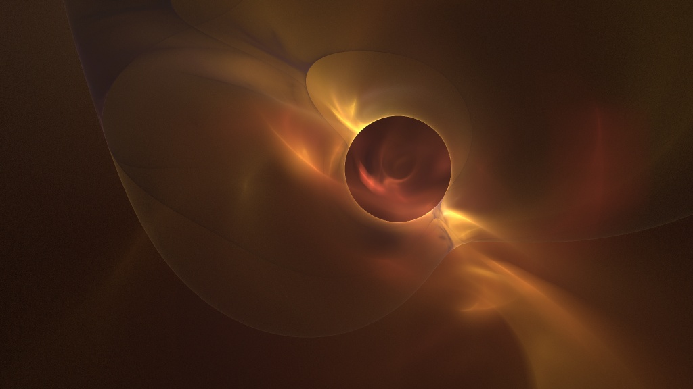
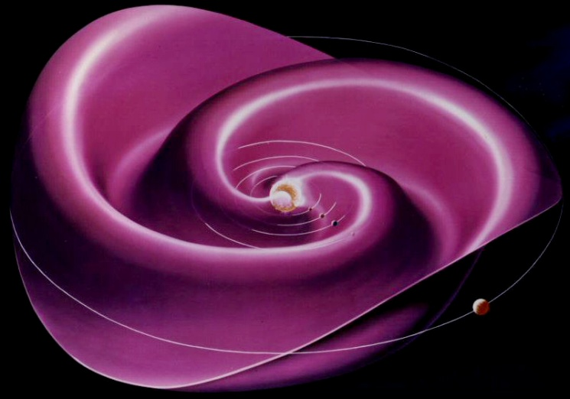
Solar Wind and Magnetic Field
Wavy Neutral Sheet
Latitudinal Dependence
B = 0

Slide 13
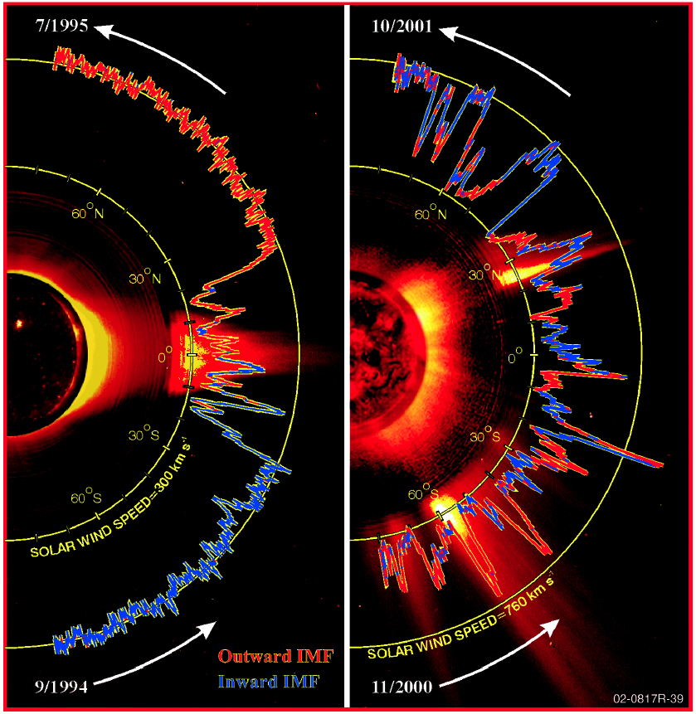
Solar Wind
Low Solar Activity
High Solar Activity
Different speed latitudinal profiles depending on the solar cycle phase
No defined polarity A during high solar activity at maximum

Slide 14
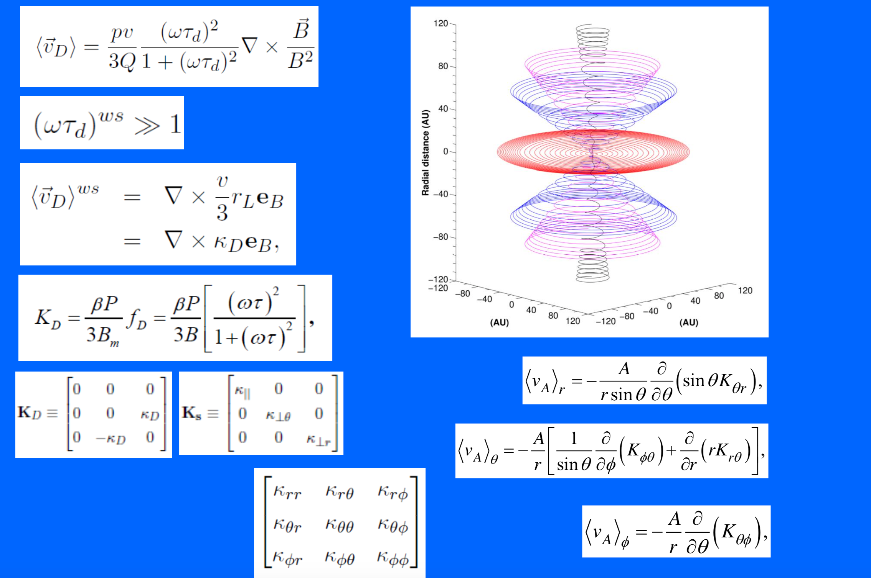

Slide 15
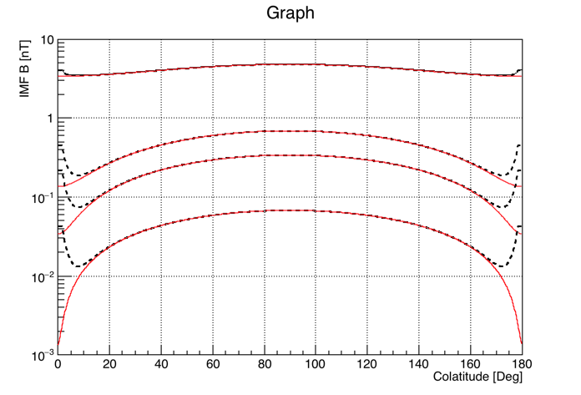
R = 50 AU
R = 10 AU
R = 5 AU
Parker Field + Jopikii&Kota Mod
R = 1 AU
Ideal Parker Field
With V_{SW} = 400 kms⁻¹

Slide 16
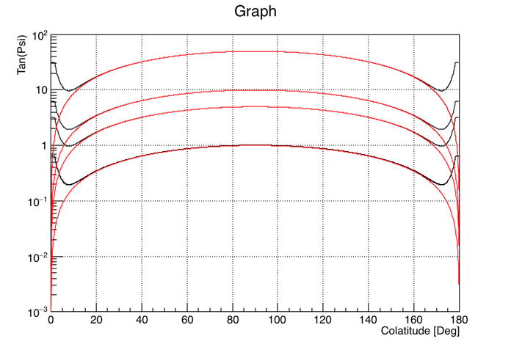
R = 50 AU
R = 10 AU
R = 5 AU
R = 1 AU
With V_{SW} = 400 kms⁻¹
tg(ψ)=
Modified Geometry (Smith&Bieber, 1991)
tg(ψ)=
Ideal Parker Field Spiral Angle

Slide 17
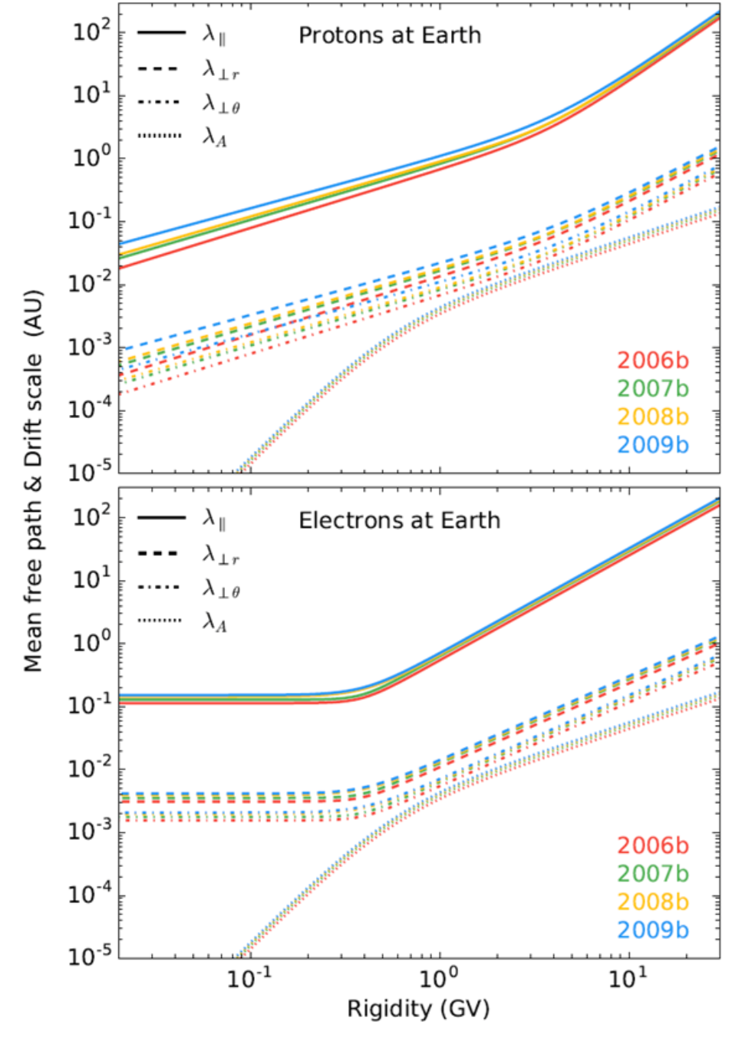
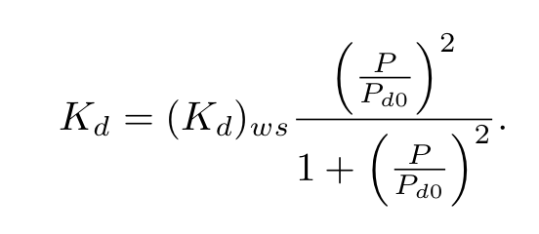
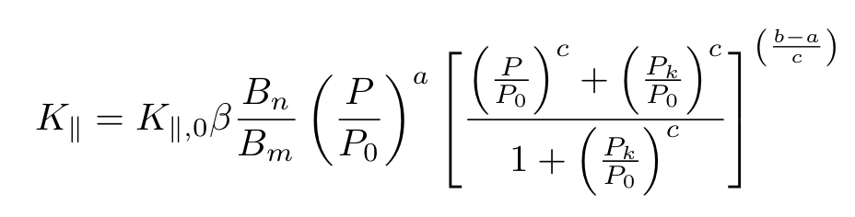


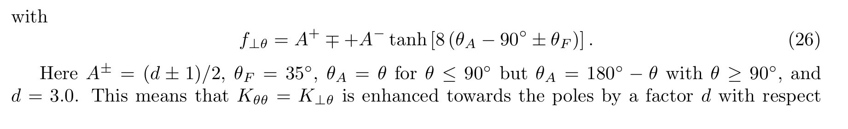
Diffusion coefficents
A
F_{nr}K||
F_{nr}= F_{nθ} = 0.02 as default
F_{nθ}K||

Slide 18
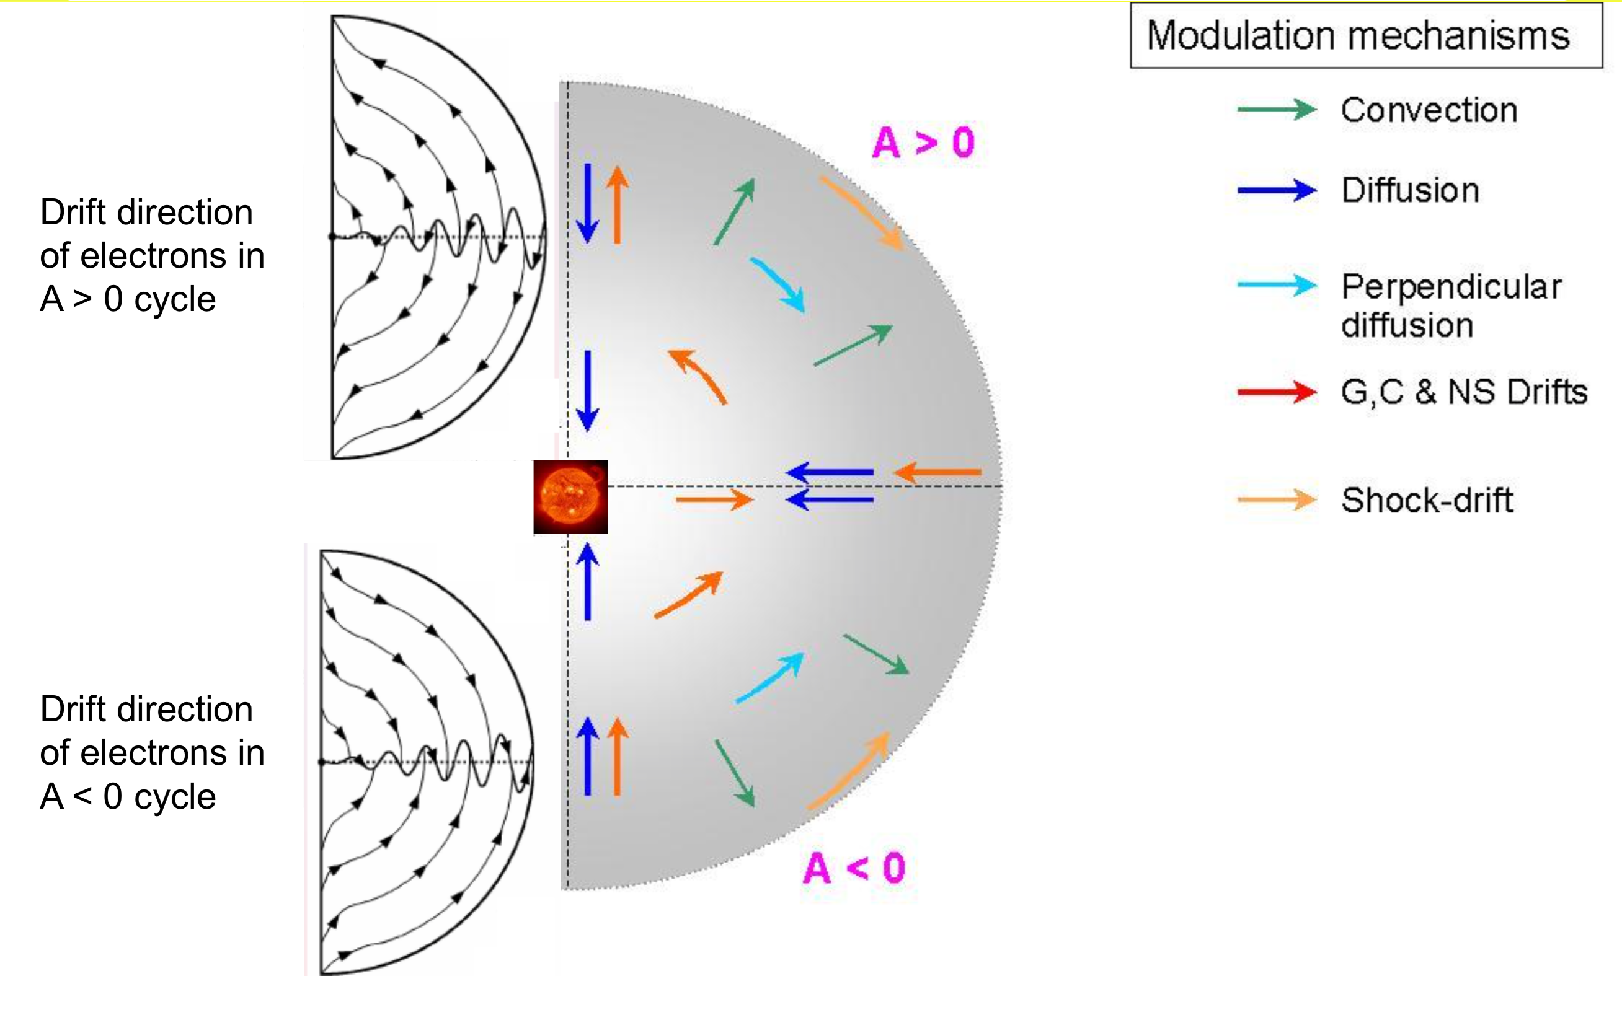
qA < 0
Drift directions of particles for qA<0
Drift directions of particles for qA>0
qA > 0

Slide 19
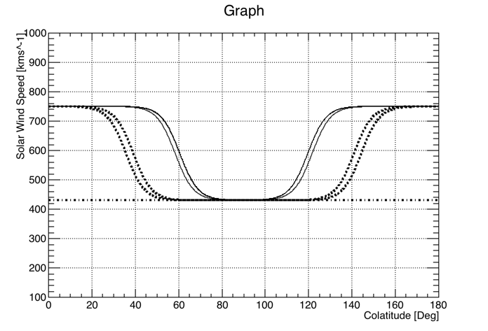
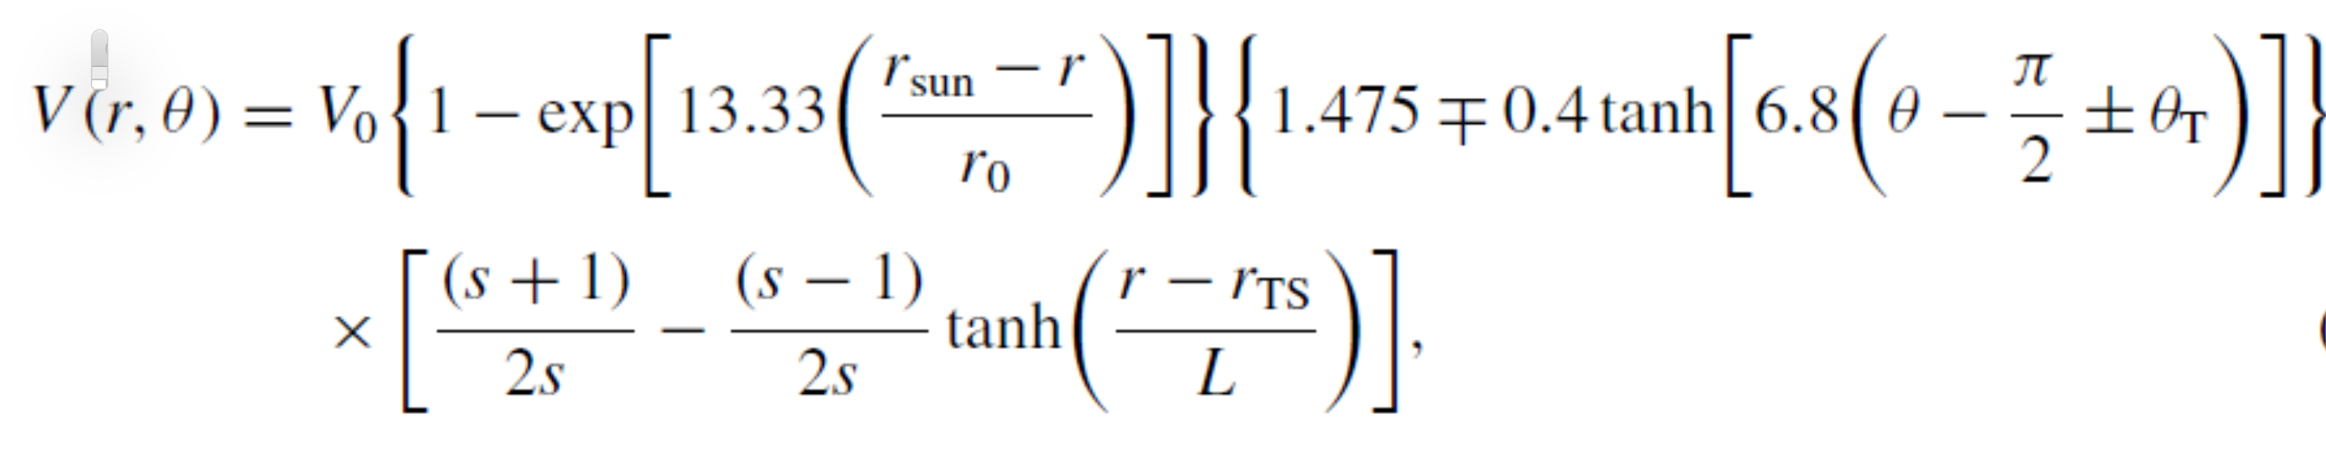
Model of solar wind speed latitudinal dependence
Termination Shock compression ratio S = 2.5
TS scale length L = 1.2 AU
TS position r_{TS} = 90 AU
V₀ = 400 km/s
Tilt Angle < 15°
Solar Min
15° <Tilt Angle < 40°
Tilt Angle > 40°
Solar Max
Potgieter et al., 2015

Slide 20
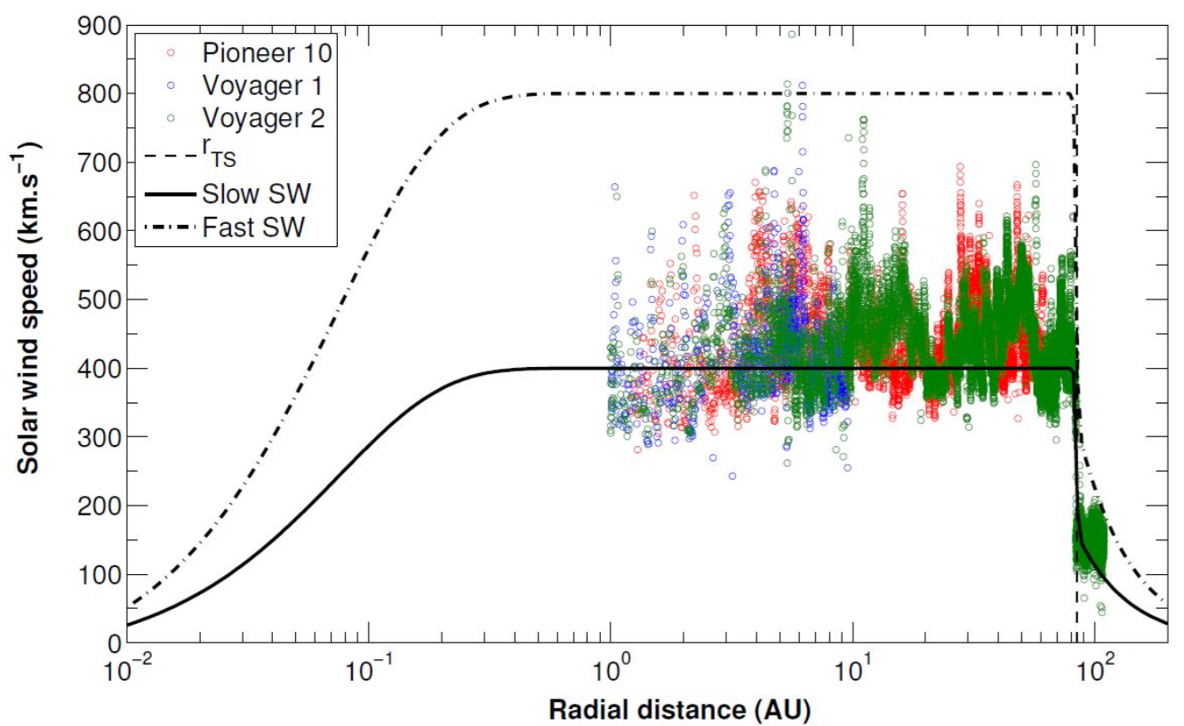
Solar Wind Speed Radial Dependence
r_{TS}
High Latitude
Low Latitude
Termination Shock compression ratio S = 2.5
TS scale length L = 1.2 AU
TS position r_{TS} = 90 AU
V₀ = 400 km/s

Slide 21
LEAP87
ATIC
He
AMS01
BESS Polar II
NO tilt angle data
BESS
BESS Polar I
SMILI I, MASS89
NB: tensione fra i dati di smili e mass
SMILI II, MASS91

Slide 22
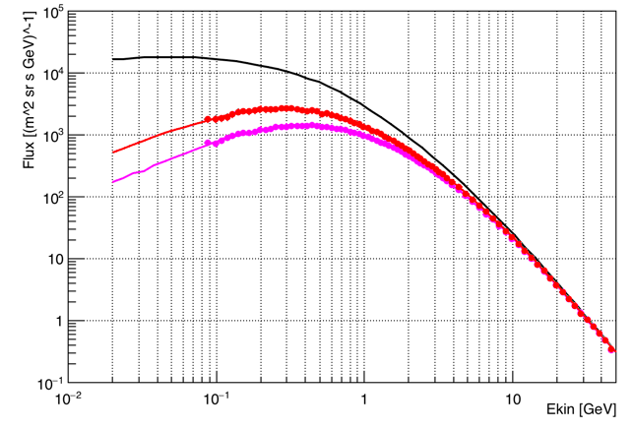
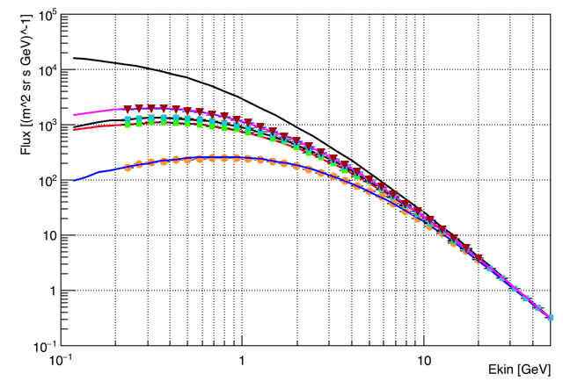
Pamela 2007/7, A>0
Proton Modulation
Pamela 2009/7, A>0
Bess 1997/7 A<0. Min
Bess 1998/8 A<0
Bess 1999/8 A<0
Bess 2000/8 A<0, Max

Slide 23
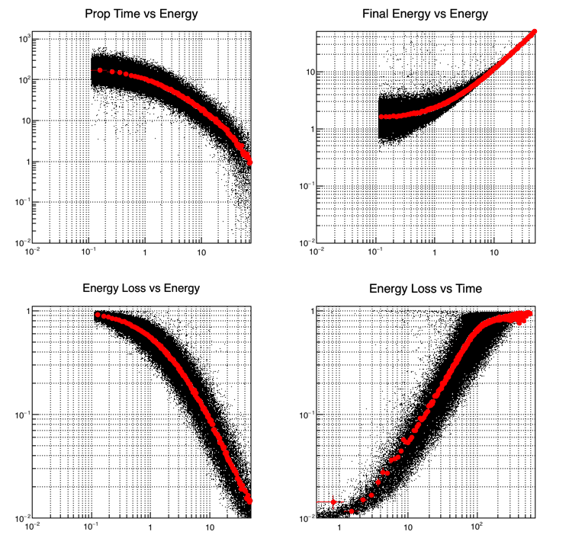
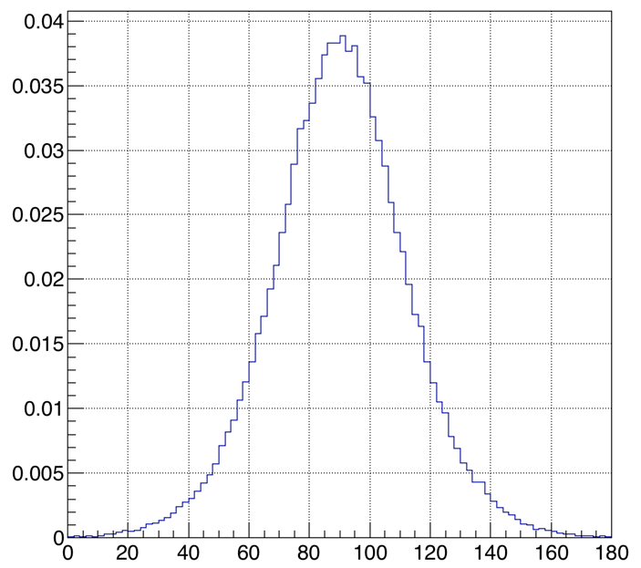
Proton Propagation
P(θ)
Prop Time [Days]
Initial Energy []GeV
Kinetic Energy [GeV]
Kinetic Energy [GeV]
ΔE/E
ΔE/E
Entrance Latitude [Deg]
2009
Polarity A >0
Kinetic Energy [GeV]
Prop Time [Days]

Slide 24
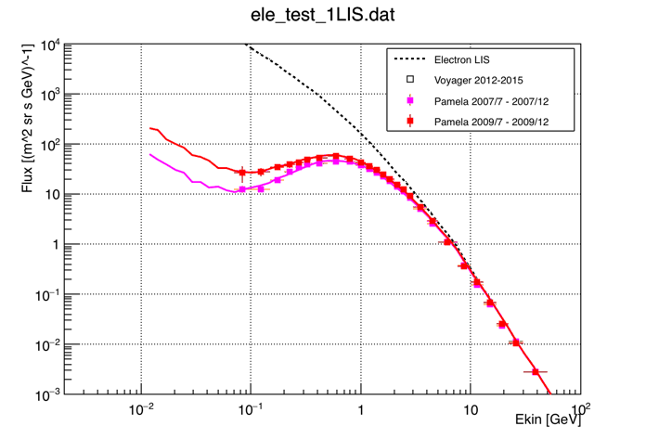
Electron modulation

Slide 25
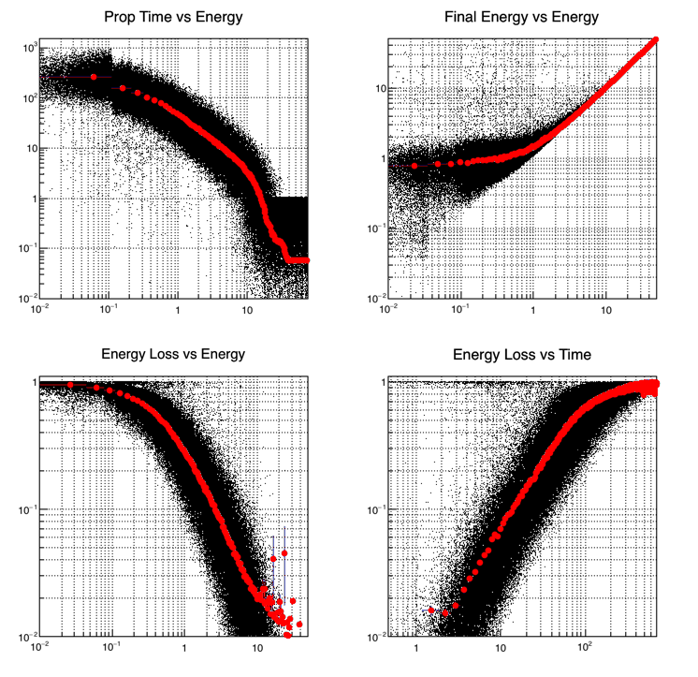
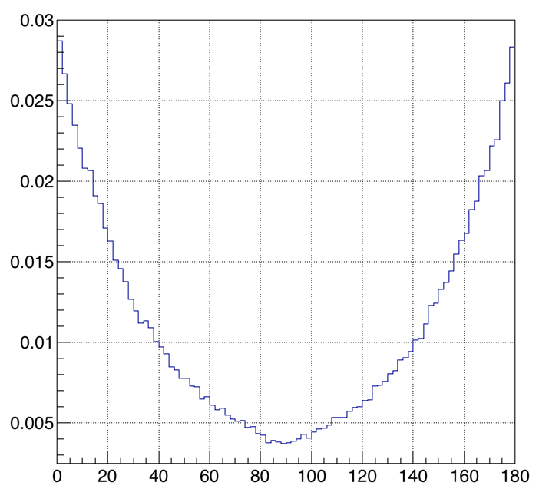
Electron Propagation
Prop Time [Days]
Initial Energy []GeV
P(θ)
Kinetic Energy [GeV]
Kinetic Energy [GeV]
ΔE/E
ΔE/E
Entrance Latitude [Deg]
Kinetic Energy [GeV]
Prop Time [Days]
2009
Polarity A>0

Slide 26
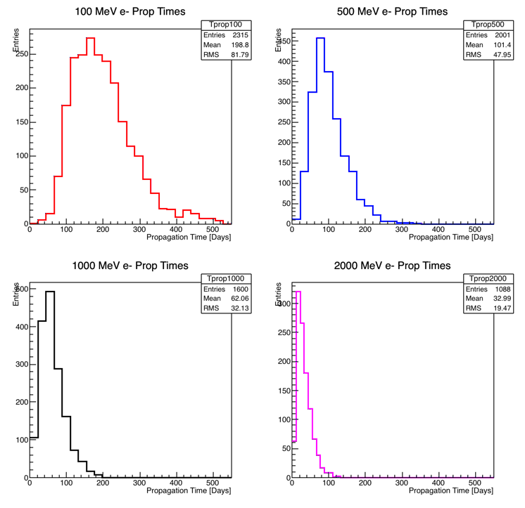

Slide 27
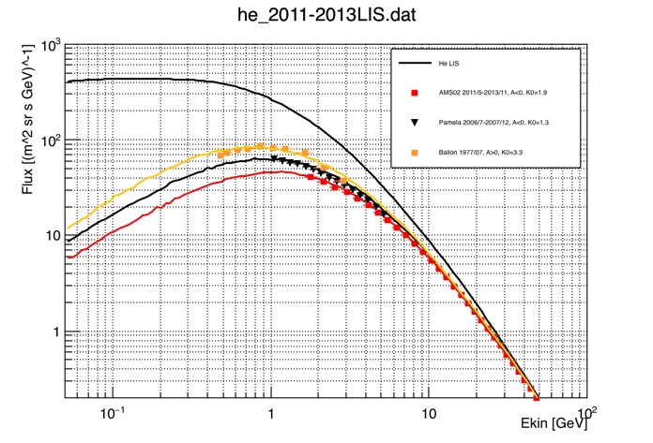
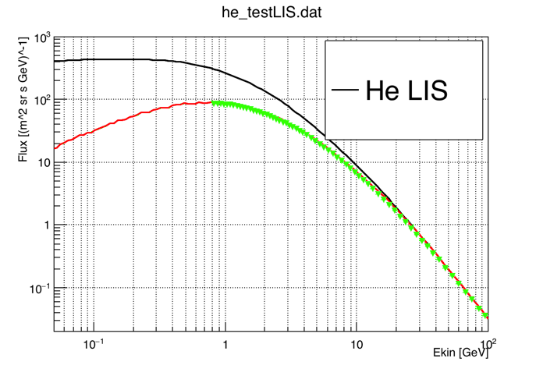
Helium Modulation
He modulation using the proton model parameters
Bess Polar 2007/12

Slide 28
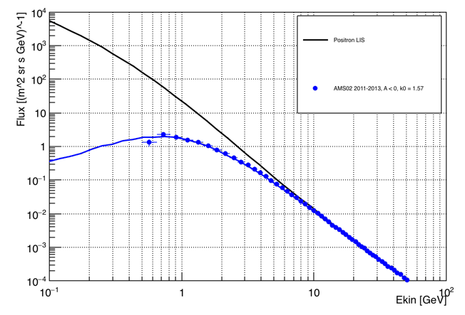
Antiprotons & positrons
pbar
Flux (m sr s Gev)⁻¹
Kinetic Energy [GeV]

Slide 29
Goals
Set up a realistic global modulation model to describe the propagation of CR in the heliosphere
Time lag for e- and He
Compare modulation in A<0 and A>0 periods for all the particles
Charge dependence of modulation
Role of diffusion and drifts at min and max solar activity
Use BESS, PAMELA and AMS02 data
Compare unusual minimum of cycle 24 to the previous one
Study modulation of light ions (Li, Be, B, C,…)
Make the model fully 3d
Many different LIS spectra around
We are using milan group public LIS Spectra
We need the most up-to-dated LIS spectra
NO e+ reliable LIS spectrum

